Slide 1
TECHNICAL SEMINAR ON IMAGE COMPRESSION TECHNIQUES
Presented by ,
Gagan A 4UB19CS021
UNDER THE GUIDANCE OF
Smt. Anitha G

Slide 2
Introduction
Image compression is a critical technique for reducing the size of digital images, while still maintaining an acceptable level of image quality.
The main goal of image compression techniques is to compress the image file size without sacrificing the quality of the image to an unacceptable degree.

Slide 3
Need for image compression
Compressing the digital images can significantly reduce their file size, making it easier to store, transfer, and share them in situations like storing in mobile devices or when uploading images to websites.
Compressed images can be transmitted more quickly, making them more practical for online sharing and communication.

Slide 4
DIFFERENT TECHNIQUES
Lossless compression techniques:
Is a form of data compression that reduce file sizes without sacrificing any significant information in the process .
Run-length encoding (RLE):
Huffman coding:
Lempel-Ziv-Welch (LZW) compression:
Lossy compression techniques:
In lossy compression, the data in a file is removed and not restored to its original form after decompression.
Discrete Cosine Transform (DCT):
Wavelet compression:
Fractal compression:

Slide 5
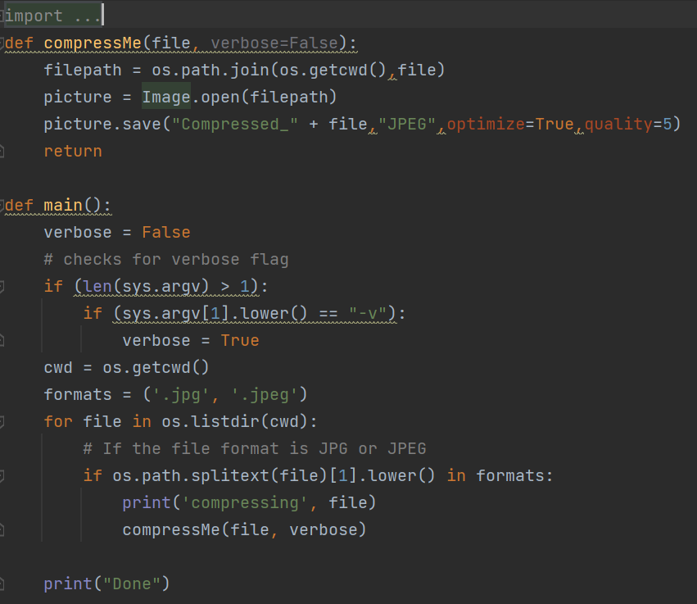
IMPLEMENTATION
working
Source code
The image compression can be done by using the python library Pillow.

Slide 6
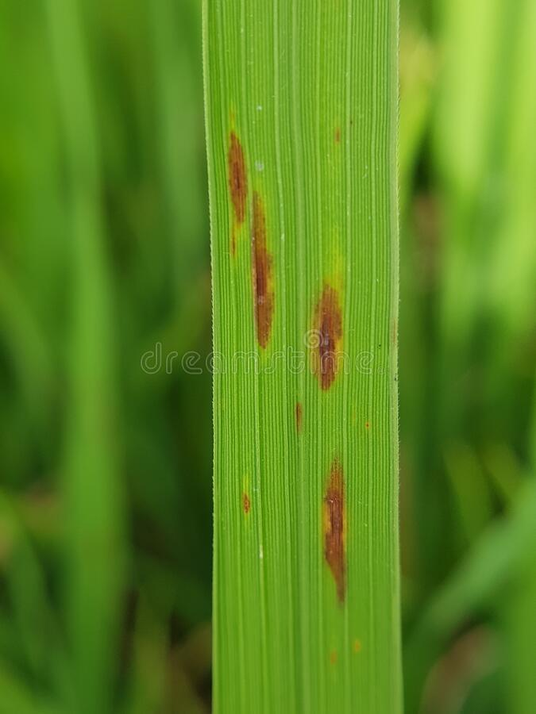
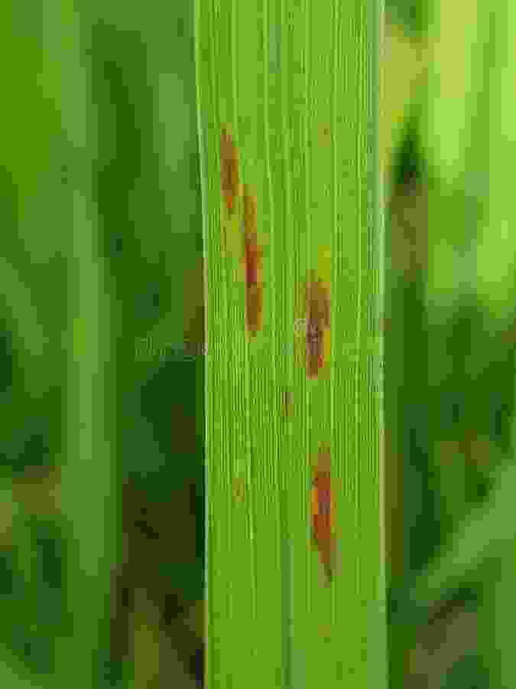
OUTPUT
IMAGE BEFORE COMPRESSION
IMAGE AFTER COMPRESSION

Slide 7
BENEFITS
Reduced file size
Faster loading times
Lower storage costs
Increased accessibility
Improved user experience
Environmental benefits

Slide 8
Limitations
Loss of quality
Complexity
Compatibility
Copyright issues
Compression ratio limitations

Slide 9
Applications
Internet and Web-based applications
Storage
Medical Imaging
Digital Cameras
Video Conferencing
Gaming

Slide 10
CONCLUSION
In conclusion, image compression techniques play a crucial role in reducing the file size of digital images while maintaining an acceptable level of image quality.

Slide 11
THANK YOU

